Slide 1
PROJECT TITLE: KISAN BUDDY
PIP104 University Project-II
Review -3
Batch Number: 7CIT G-18
Roll Number | Student Name
20211CIT0098 | VINAY GOWDA R
20211CIT0137 | DEVIKA N
20211CIT0141 | KEERTHANA R
20211CIT0144 | SUSHMITHA NC
Under the Supervision of,
Dr. Sharmasth Vali Y
Professor of Department CCS,CIT
School of Computer Science & Engineering
Presidency University

Slide 2
INDEX
Abstract
Introduction
Literature review
Existing Method
Drawbacks
Proposed method
Applications
Hardware and Software Requirements
Results
Conclusion
References

Slide 3
Abstract
This software application is basically for sustainable development of farmers. Many times farmer is confused to take decisions regarding selection of fertilizer, pesticide and time to do particular farming actions.
So to avoid this problem this application is very useful. Fertilizer schedule of each type of crop will get registered.
Based on sowing date of crop, farmer will get reminders about application of fertilizer, herbicide as per schedule, pesticide for diseases and weather alerts if particular crop exceeds its favorable temperature range.
Crop suggestion will be given based on Soil type, geographical location. Farmer will get real time national level crop rates to get more benefit.

Slide 4
Introduction
Fertilizers Android app development would be the fastest growing global fertilizer market in the next decade.
The rise in demand for advanced fertilizers and increasing crop production are expected to drive the market of Fertilizers Android app development.
Fertilizer is an important aspect of agriculture and its development. As such, it's helpful to use an app on this important subject.
The development of Fertilizers app will promote the improvement of agricultural production. So to avoid this problem this application is very useful.
Fertilizer schedule of each type of crop will get registered. Based on sowing date of crop, farmer will get reminders about application of fertilizer, herbicide as per schedule, pesticide for diseases and weather alerts if particular crop exceeds its favorable temperature range.
Crop suggestion will be given based on Soil type, geographical location. Farmer will get real time national level crop rates to get more benefit.

Slide 5
Existing method:
Agriculture is the backbone of India. Farmers need advice to take decision during their farming activities such as land preparation, sowing, irrigation management, fertilizer management, pest management and storage for higher production of crop.
Application of required amount of fertilizer at proper time and proper proportion will help in increasing the overall productivity of the farm and also safe guards the soil health and microbial biodiversity.
Growing trends in Agricultural Automation has led to a tremendous development of software and applications to foster information dissemination.

Slide 6
Literature review:
S. NO | Journal Type with year | Authors | Title | Outcomes
1 | 2014 | Aniket Bhave, Rahul Joshi, Ryan Fernandes | An Android Based Solution for Remunerative Agriculture | https://ijrat.org/downloads/Vol-2/april-2014/paper%20id-24201412.pdf
2 | 2015 | Rachana P. Koli1 , V. D. Jadhav2 | Agriculture Decision Support System As Android Application | https://www.ijsr.net/archive/v4i4/SUB153091.pdf
3 | 2013 | Lantzos, T., Koykoyris, G., & Salampasis, M | FarmManager: an Android application for the management of small farms | https://www.sciencedirect.com/science/article/pii/S2212017313001461

Slide 7
Proposed method:
Fertilizers are materials that are added to soil for the purpose of enhancing soil fertility and improving crop yield.
This mobile app can help farmers in using fertilizers effectively, so as to achieve economic agriculture growth.
The app offers you a wide range of services that makes sure that all your needs are taken care of. This mobile app is a great help to the farmers and it has become a powerful platform where they can interact with anyone they want to.
To design an Android Application, first of all, you need to determine what type of application you want to build.

Slide 8
Modules:
The App which contains 3 modules they are
Farmer: Farmer signup and login, after login farmer can buy the fertilizers for the crops, at the sometime farmer can sell their products from the app.
Users: User can sign up and login, after login user can buy the products from the farmers.
Admin: Admin can add the Smart Agriculture to database.

Slide 9
Hardware and Software Requirements
H/W System Configuration :-
Processor - I3/Intel Processor
RAM - 8 GB
Hard Disk - 1TB
Key Board - Standard Windows Keyboard
Mouse - Two or Three Button Mouse
Monitor - Any
S/W System Configuration :-
Operating System - Windows 11
Server-side Script - PHP
Database - My SQL 6.0

Slide 10
Results and Discussions:

Slide 13
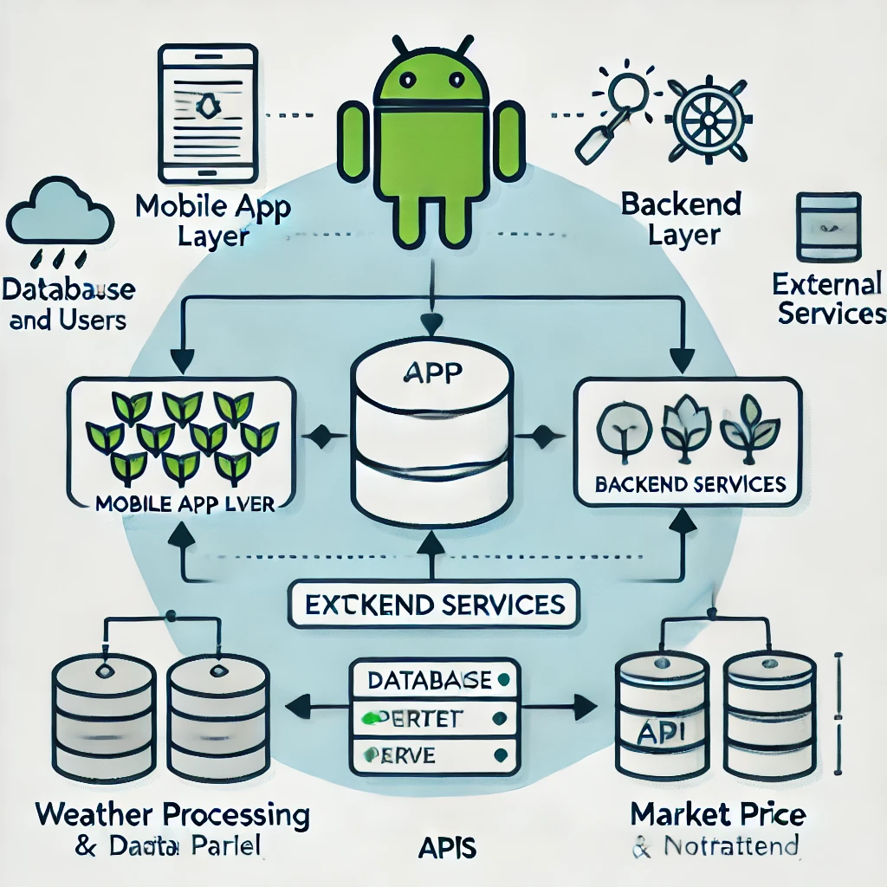
Architecture diagram:

Slide 14
Conclusion:
Smart Agriculture app helps in delivering the crop specific fertilizer quantity to be applied for the cropped area, this helps the farmers to reduce the cost incurred for them in over application of fertilizer.
Further the productivity of the farm is increased by application of appropriate proportion of major nutrients.
The future scope of the Smart Agriculture is that GPRS can be included such that the location specific nutrient recommendation can be given for the crop.
Further this app would be incorporated as a part of the precision agriculture wherein sensors can be used to find the amount of NPK present in the soil and that amount can be deducted from the recommendation thus providing us with the precise amount of nutrients to be applied.

Slide 15
References:
[1] Aniket Bhave, Rahul Joshi, Ryan Fernandes(2014) ―MahaFarm – An Android Based Solution for Remunerative Agriculture‖, International Journal of Research in Advent Technology, Vol.2, No.4
[2] Rachana P. Koli1 , V. D. Jadhav2 (2015), ― Agriculture Decision Support System As Android Application‖, International Journal of Science and Research, Vol. 4 Issue 4
[3] Lantzos, T., Koykoyris, G., & Salampasis, M. (2013) ―FarmManager: an Android application for the management of small farms‖, Procedia Technology, 8, 587-592.
[4] Prasad, S., Peddoju, S. K., & Ghosh, D. (2013) ―AgroMobile: A Cloud-Based Framework for Agriculturists on Mobile Platform‖, International Journal of Advanced Science and Technology, 59, 41- 52.
[5] Santosh Reddy, Abhijeet Pawar, Sumit Rasane, Suraj Kadam (2015) ―A Survey on Crop Disease Detection and Prevention using Android Application‖, International Journal of Innovative Science, Engineering & Technology, Vol. 2, Issue 4.

Slide 16
Thank You

